Slide 1
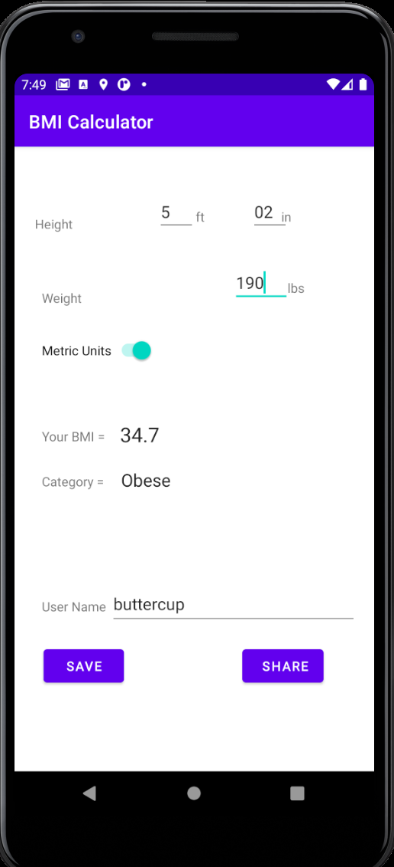
BMI Calculator CS-683-F20 Project Dharmendra Thotakura

Slide 2
BMI Calculator – CS-683-F20 What can you this with his application?
If height and weight are given it gives the BMI Value.
It gives the BMI category for the computed BMI Value.
It can take both US Units and Metric units for height/weight
It saves your data to SQLite database with your username
It lets you share your current BMI value as text message/mail
It does not share your data with App developers and does not show Ads and maintains the privacy

Slide 3
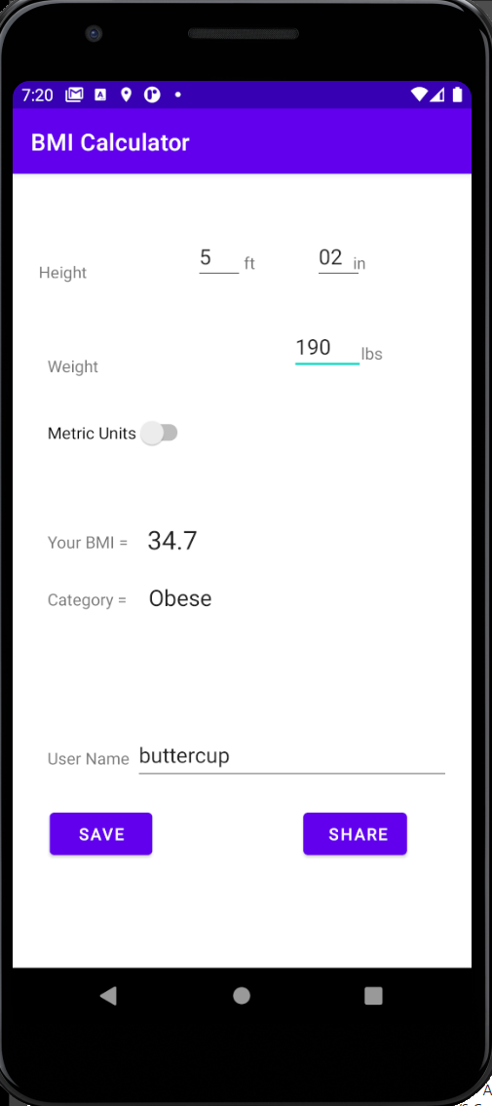
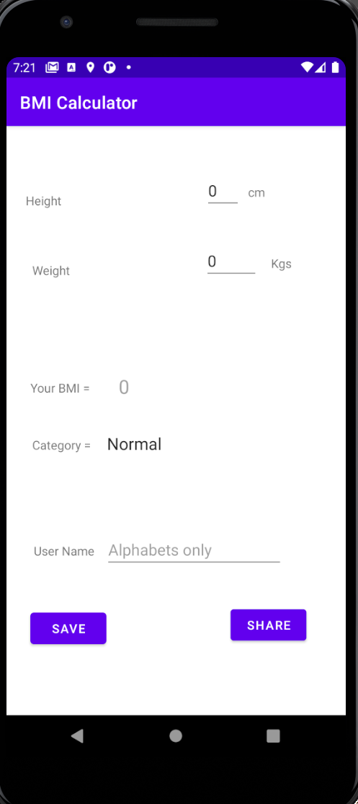
DEM0 of the BMI Calculator

Slide 4
How does BMI Calculator Application work?
Application takes the height and weight inputs from the user using Edit Text View.
It can toggle from US units to Metric view with a toggle Switch button and using a respective second activity and layout
Text inputs of height and weight are converted to float and BMI formula is applied on them
BMI category is set based on respective BMI value.
It takes the username as input for user who wishes to save the data.
It creates an SQLite instance data base and saves the BMI value with username and time stamp.
It uses implicit intent actions and let user share the BMI value through text or mail

Slide 5

Code Walk through

Slide 6
What are the validations present in the Application?
Toast notifications are used for informing user when validation fails
It restricts users to give integers for height and decimals for weight
It restricts users from giving inputs outside specified ranges for height and weight
Only alphabets are allowed for username
Null values are not allowed any where.
Saving is optional but checks for Username and BMI Value
Sharing requires BMI value to be present.

Slide 7
Validations Demo

Slide 8
Things that were tough to implement
Getting the Constraint layout correct to fit the screen right
Implementing SQLite and queries can have typos
Implementing Toast notifications on emulator. It required an emulator hard boot to work properly
Things that I did not get to do but if done elevates the App
Move the metric toggle to the top of the layout
Should have created a new button for BMI calculation
Populate existing usernames by reading the SQLite DB
Create a user specific time graph for BMI value trend
Give option to user to export all his records to csv and share to application that handle CSVs.

